Slide 1
Hitchhiker’s Guide To Understanding Comparability Universes
Jonathan Holtzman, RPLG
Michael Nadol, PFM Group
CALPELRA
November 21, 2019

Slide 2
HITCHHIKER’S GUIDE TO THE GALAXY
“A common mistake people make when trying to design something completely foolproof is to underestimate the ingenuity of complete fools.” Douglas Adams, Mostly Harmless (1992)

Slide 3
COMPARATIVE PERSPECTIVE

Slide 4
DEFINING A UNIVERSE

Slide 5
BASICS FOR BUILDING YOUR UNIVERSE
Historical
Type of Entity and Job
Proximity
Population
Labor Market
Community Factors

Slide 6
CRITERIA #1: HISTORICAL
If you have a historical universe, the burden is often on the party that wishes to change that universe
Historical universes are frequently given great weight in factfinding and arbitration
This does not mean that you should avoid revisiting your historical universe because
many historical universes are not put together well in the first place
jurisdictions change in both size and demographics

Slide 7
CRITERIA #1: HISTORICAL
Santa Rosa vs. Santa Clara
About a decade ago, Santa Clara home values were <25% higher than Santa Rosa’s; as of 2017, that gap had widened to >75% higher
Similarly, Santa Clara median household incomes, already nearly 1/3 higher in 2007, are more than 50% higher as of 2017
 | Median Home Value (2007) | Median Home Value (2017) | Median Household Income (2007) | Median Household Income (2017)
Santa Rosa | $557,800 | $568,200 | $56,966 | $75,356
Santa Clara | $686,400 | $1,001,100 | $75,687 | $115,375
Santa Rosa Lead / Lag ($) | ($128,600) | ($432,900) | ($18,721) | ($40,019)
Santa Rosa Lead / Lag (%) | (23.1%) | (76.2%) | (32.9%) | (53.1%)

Slide 8
CRITERIA #2: TYPE OF ENTITY AND JOB
Type of entity (e.g. city, county, type of district) is generally considered very important
However, it is not clear that this should be the case for all types of jobs
There is a great deal of overlap in the types of workers employed by cities and counties
If you are doing a survey in a city, the county in which it is located can be highly comparable for many jobs
On the other hand, scale, organizational responsibilities, career paths and promotional opportunities, and employer financial factors can all vary significantly
Universes may be different for different jobs (e.g. higher-level jobs may recruit from a wider universe)

Slide 9
CRITERIA #3: PROXIMITY – BY MILES
Ignores historical commute patterns and physical barriers (e.g. rivers, mountains)
Does not necessarily track where you are hiring from or where your people might be leaving to
Does not necessarily correlate with localized labor markets and cost-of-living
City | Distance (miles)
Fremont | 85.0
Santa Rosa | --
Hayward | 73.1
Concord | 75.2
Berkeley | 54.6
Vallejo | 42.1
Antioch | 75.0
Fairfield | 54.5
Richmond | 48.7
Daly City | 58.9
San Mateo | 73.3
Vacaville | 64.6
Livermore | 90.6
Modesto | 139.7
Sunnyvale | 101.1
Santa Clara | 101.0
Tracy | 105.0

Slide 10
CRITERIA #3: PROXIMITY - MSA
A Metropolitan Statistical Area (MSA) is an urbanized region with a high degree of economic and social integration, determined by the federal government based on analysis of commuting patterns and employment interchange across counties
Effectively, an MSA is a labor market

Slide 11
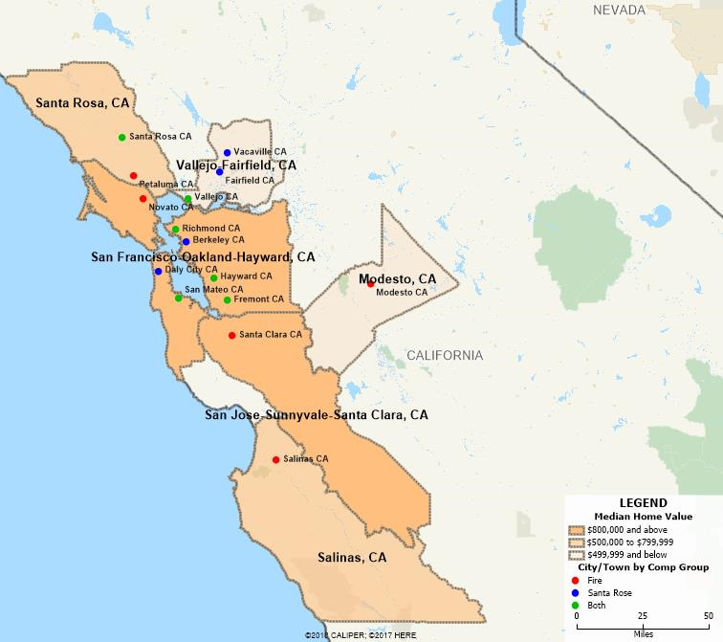
CRITERIA #3: PROXIMITY – MSA
MSA | City Comparators in MSA | Union Comparators in MSA | Median Household Income | Median Home Value | Median Owner Costs
San Francisco-Oakland-Hayward MSA | Berkeley, Daly City, Fremont, Hayward, Richmond, San Mateo | Fremont, Hayward, Novato, Richmond, San Mateo | $101,714 | $849,500 | $2,985
San Jose-Sunnyvale-Santa Clara MSA | -- | Santa Clara | $117,474 | $957,700 | $3,261
Santa Rosa MSA | Santa Rosa | Santa Rosa, Petaluma | $80,409 | $628,400 | $2,382
Salinas MSA | -- | Salinas | $71,274 | $517,200 | $2,159
Vallejo-Fairfield MSA | Fairfield, Vacaville, Vallejo | Vallejo | $77,133 | $411,700 | $2,131
Modesto | -- | Modesto | $59,514 | $288,200 | $1,606

Slide 12
CRITERIA #4: POPULATION
Large and small entities are generally recognized to be different
The challenge is what is your cutoff threshold
RPLG has commonly used +/- 50% but there is no magic in this number
Calibrating criteria can depend on the degree of challenge involved with identifying a reasonable sample size, as well as the need to balance different relevant factors

Slide 13
CRITERIA #4: POPULATION
City | 1/1/16 Population | Within Range?
San Jose | 1,042,094
San Francisco | 866,583
Oakland | 422,856
Stockton | 315,592
Fremont | 229,324 | Y
Modesto | 211,903 | Y
Santa Rosa | 175,667 | Y
Hayward | 158,985 | Y
Sunnyvale | 148,372 | Y
Concord | 129,707 | Y
Santa Clara | 123,752 | Y
Berkeley | 119,915 | Y
Vallejo | 117,322 | Y
Antioch | 112,968 | Y
Fairfield | 112,637 | Y
Richmond | 110,378 | Y
Daly City | 109,139 | Y
San Mateo | 102,659 | Y
Vacaville | 97,667 | Y
Tracy | 89,208 | Y
Livermore | 88,138 | Y
San Leandro | 87,700
Redwood City | 85,992
Napa | 80,576
Alameda | 79,277
San Ramon | 78,363
Mountain View | 77,925

Slide 14
CRITERIA #5: LABOR MARKET – RECRUITMENT AND RESIDENCE DATA
Agency-specific recruitment and residence data (zip code analysis) can often further paint a picture of your labor market
Different occupations can have different recruitment markets
Executive/leadership: often statewide or even national
Labor, trades, clerical: often highly localized given competition with the private sector
Firefighters: sometimes a broader market due to the lower number of annual appearances required under
24-hour schedules

Slide 15
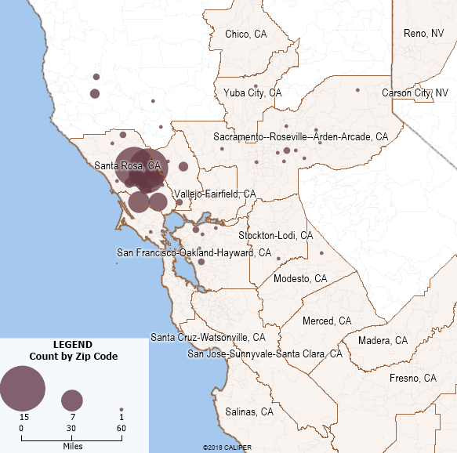
CRITERIA #5: LABOR MARKET – RECRUITMENT AND RESIDENCE DATA
Santa Rosa Local 1401 Labor Market
Based on zip code analysis of current residence, 61% of the Santa Rosa Fire Fighters Local 1401 live in communities within the Santa Rosa MSA
Over 85% live in communities outside of the core Bay Area labor market (San Francisco-Oakland-Hayward, MSA) and none live within the higher wage/higher cost Silicon Valley (San Jose-Sunnyvale-Santa Clara MSA)
MSA | Employees (As of 12/31/2018) | %
Santa Rosa | 75 | 61.0%
San Francisco-Oakland-Hayward | 17 | 13.8%
Vallejo-Fairfield | 1 | 0.8%
Modesto | 1 | 0.8%
San Jose-Sunnyvale-Santa Clara | 0 | 0.0%
Salinas | 0 | 0.0%
Other | 29 | 23.6%
Total | 123 | 100.0%

Slide 16
CRITERIA #5: LABOR MARKET – RECRUITMENT AND RESIDENCE DATA
City Recruitment Experience
Over the last five years, City’s Fire department had four (4) open recruitments for Firefighters-Paramedics
In every case, the number of applicants has significantly exceeded the available positions, such that many candidates meeting the minimum qualifications were not even asked to complete the certification process
Filing Period | Applications | Met Minimum Qualifications | Candidates Certified | Candidates Hired
6/24/14 - 7/714 | 425 | 324 | 34 | 6
1/11/16 – 1/25/16 | 247 | 209 | 55 | 6
7/26/17 – 8/4/17 | 130 | 89 | 42 | 6
1/16/18 – 2/6/18 | 125 | 100 | 41 | None

Slide 17
CRITERIA #5: LABOR MARKET – RECRUITMENT AND RESIDENCE DATA
Relative to the Society for Human Resource Management’s 2017 national survey of over 2,000 employers, total IAFF turnover was well below the benchmark average of 18 percent and median of 14 percent across industries
IAFF turnover is also below BLS Job Openings and Labor Turnover Survey (JOLTS) data indicating 2017 separation rates of nationally of 29.1 percent in the private industry and 9.5 percent for state and local government workers nationally
City IAFF turnover rates are favorable relative to other City bargaining units
City Retention Experience
An agency’s ability to recruit and retain workers is one of the best measures of the strength of its compensation package
Fiscal Year |  | 2014 | 2015 | 2016 | 2017 | 2018
Headcount |  | 122 | 123 | 120 | 123 | 124
Number of Separations by Reason
Service Retirement |  | 8 | 2 | 2 | 0 | 3
Disability Retirement |  | 0 | 1 | 0 | 1 | 3
Involuntary Discharge |  | 0 | 0 | 1 | 0 | 0
Failed Probation |  | 1 | 1 | 0 | 0 | 0
Voluntary |  | 2 | 0 | 0 | 0 | 1
Total Separations |  | 11 | 4 | 3 | 1 | 7
Total Turnover Rate |  | 9.0% | 3.3% | 2.5% | 0.8% | 5.6%
Total “Quit” Rate |  | 1.6% | 0.0% | 0.0% | 0.0% | 0.8%

Slide 18
CRITERIA #6: COMMUNITY FACTORS
Different contextual factors such as income, population trends, poverty rates, home values and sales prices, tax base, bond ratings, etc. can help draw similarities and differences between jurisdictions / employers

Slide 19
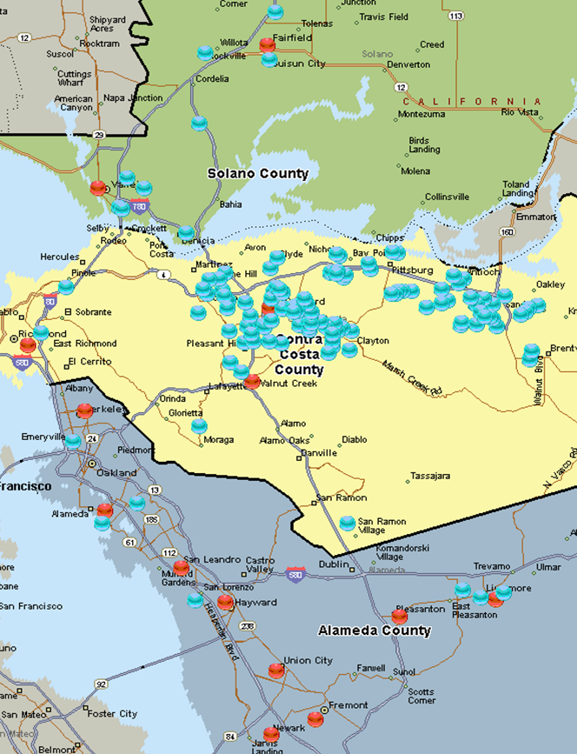
CRITERIA #6: COMMUNITY FACTORS
City of Concord Community Factors
 | Population (1/1/15) | Unemployment March 2016 | Median Household Income | Median Family Income
Alameda | 76,638 | 3.7% | $76,439 | $93,427
Antioch | 108,298 | 6.3% | $65,770 | $73,023
Berkeley | 118,780 | 3.4% | $65,283 | $114,720
Fairfield | 111,891 | 5.1% | $66,190 | $75,091
Fremont | 226,551 | 3.3% | $103,591 | $112,347
Hayward | 152,889 | 6.0% | $62,691 | $69,415
Livermore | 85,990 | 2.9% | $99,683 | $111,950
Newark | 44,204 | 3.6% | $86,521 | $91,103
Pleasanton | 74,850 | 3.3% | $123,608 | $140,311
Richmond | 107,346 | 5.2% | $54,857 | $59,976
San Leandro | 88,441 | 4.6% | $64,279 | $76,781
Union City | 72,744 | 3.9% | $82,564 | $93,050
Vallejo | 119,683 | 7.7% | $58,472 | $67,543
Walnut Creek | 66,868 | 3.1% | $80,399 | $112,114
Concord | 126,069 | 4.9% | $67,122 | $78,218
Median (Excluding Concord) | 97,894 | 3.8% | $71,315 | $92,077
Concord Variance from Median | 28.8% | 28.9% | -5.9% | -15.1%
Concord Rank | 3 of 15 | 10 of 15 | 8 of 15 | 9 of 15

Slide 20
CRITERIA #6: COMMUNITY FACTORS
City of Concord Community Factors
 | Median Home Value | Median Monthly Owner Costs (w/Mortgage) | Median Gross Rent
Alameda | $628,500 | $2,829 | $1,375
Antioch | $240,000 | $2,147 | $1,373
Berkeley | $719,500 | $2,851 | $1,338
Fairfield | $262,400 | $2,125 | $1,304
Fremont | $614,500 | $2,753 | $1,663
Hayward | $339,700 | $2,241 | $1,312
Livermore | $490,700 | $2,717 | $1,492
Newark | $455,500 | $2,463 | $1,570
Pleasanton | $732,100 | $3,266 | $1,742
Richmond | $271,300 | $1,956 | $1,190
San Leandro | $372,600 | $2,256 | $1,260
Union City | $484,300 | $2,621 | $1,513
Vallejo | $222,100 | $1,917 | $1,208
Walnut Creek | $591,700 | $2,897 | $1,479
Concord | $368,900 | $2,251 | $1,321
Median (Excluding Concord) | $469,900 | $2,542 | $1,374
Concord Variance from Median | -21.5% | -11.4% | -3.9%
Concord Rank | 10 of 15 | 10 of 15 | 10 of 15

Slide 21
EMPLOYEE ARGUMENTS/CONCERNS
Proximity comparators (mutual aid)
Contiguous ≠ comparable
Other potential employers (are there particular competitors successfully recruiting your personnel)
Are the retention challenges significant? Is it practical to compete?
Working conditions (hazards, “productivity”) – more to come
Career opportunities
Are career paths and promotional opportunities distinctive? (may correlate to scale, organizational type and structure)
Cost of living – more to come

Slide 22
WORKING CONDITIONS
Hazards:
Often inversely correlated with pay, as high crime and fire incidence often associated with poverty and weaker local economies linked to reduced ability-to-pay and lower wage labor markets
Productivity:
Are comparative service demands (e.g., call volume) and changes in service demand relevant? Would/should wages go down if crime levels or the number of structure fires were to decrease?

Slide 23
WORKING CONDITIONS
Career opportunities
It is common to benchmark rank-and-file patrol officers and firefighters, but many/most will promote above those levels during their careers
Not all agencies are the same in terms of opportunities for advancement and/or special assignments

Slide 24
REGIONAL COST AND PAY DIFFERENCES
Cost of living
CPI doesn’t compare regions (except for trends)
Tools that do have limitations – e.g., ERI
Area wage differences ≠ Area cost of living differences
Housing costs as a proxy?
Area wage differentials – federal locality pay

Slide 25
CONSOLIDATING CRITERIA
Filters approach
In or out based on meeting (or not) a set of defined parameters (e.g. population +/- XX% and median household income +/- YY% and same MSA and same form of government (e.g., city or county), etc.
Weighting approach
In or out based on points assigned to each of multiple factors determined by degree of similarity
No “one size fits all” methodology, since the available comparators to develop a reasonable sample size will vary from place to place if the exact same criteria are used
Key is to be reasonable and thoughtful – using some sort of objective and defensible approach (no “cherry-picking”)
Once the universe is selected, contextualization across that group is
also important for meaningful interpretation (more to come)

Slide 26
INTERNAL COMP & MARKET DRIFT
Factfinders and arbitrators tend to be highly concerned with internal relationships of bargaining units (i.e. percentage increases)
Factfinders and arbitrators will almost always defer to a strong internal pattern
However, it’s not uncommon to have slightly different patterns for safety and non-safety
They can also be heavily swayed by overall market drift (i.e. average percentage increases for the same period among comparable jurisdictions)

Slide 27
INTERNAL COMP & MARKET DRIFT
Barganing 2019
Summary of Economic Settlements / Awards (City Only)
 | Wages |  |  | Other Economics |  |  | Total Economic Value
MOU | FY19-20 | FY20-21 | FY21-22 | FY19-20 | FY20-21 | FY21-22 | FY19-20 | FY20-21 | FY21-22
IFPTE Local 21 | 3%/1% | 3%/0.5% | 3%/0.5% | 0.31% | 0.42% | 0.45% | 3.82% | 7.84% | 11.65%
SEIU Local 1021 - cooling off period in place
Municipal Executives' Association | 3%/1% | 3%/0.5% | 3%/0.5% | 0.15% | 0.17% | 0.25% | 3.67% | 7.59% | 11.44%
Laborers, Local 261 | 3%/1% | 3%/0.5% | 3%/0.5% | 0.41% | 0.54% | 0.54% | 3.92% | 7.96% | 11.73%
TWU Local 200 SEAM | 3%/1% | 3%/0.5% | 3%/0.5% | 0.94% | 0.94% | 0.94% | 4.45% | 8.35% | 12.13%
TWU Local 250-A 7410 | 3%/1% | 3%/0.5% | 3%/0.5% | 0.08% | 0.08% | 0.08% | 3.60% | 7.50% | 11.28%
TWU Local 250-A Multi Unit | 3%/1% | 3%/0.5% | 3%/0.5% | 0.18% | 0.14% | 0.09% | 3.70% | 7.56% | 11.28%
Building Inspectors' Association | 3%/1% | 3%/0.5% | 3%/0.5% | 0.22% | 0.22% | 0.22% | 3.74% | 7.64% | 11.41%
Operating Engineer, Local 3 | 3%/1% | 3%/0.5% | 3%/0.5% | 0.05% | 0.05% | 0.05% | 3.57% | 7.47% | 11.25%
District Attorney Investigators' Association (DAIA) | 3%/1% | 3%/0.5% | 3%/0.5% | 1.87% | 4.37% | 4.37% | 5.93% | 11.79% | 15.57%

Slide 28
SUMMARY:NO PERFECT TWINS
Having a reasonable universe does not mean there is only one true group
Even within a reasonable universe, not all employers will (or should) pay the same
Context matters both when selecting and when interpreting a comparability universe…

Slide 29
THE LAKE WOBEGON FALLACY

Slide 30
LAKE WOBEGON
“Where all the women are strong, all the men are good-looking, and all the children are above average."

Slide 31
IN THE REST OF THE WORLD
And it’s ok. Really.

Slide 32
MARKET POSITION WITHIN UNIVERSE
Often public agencies have a “historical” position within a historical universe
By definition, not every public agency can be at the median or mean unless everyone pays exactly the same
Factfinders and arbitrators generally give some deference to historical market position

Slide 33
PHILADELPHIA’S UNIVERSE
The City and its safety unions have looked to multiple universes over the years
One grouping receiving past focus is a set of major East Coast cities
Baltimore
Boston
New York City
Philadelphia
Washington, DC

Slide 34
PHILADELPHIA’S EAST COAST CITY UNIVERSE (CIRCA 2017)
 | Median Earnings Residents Age 25+ | Per Capita Income | Median Household Income | Individuals Below Poverty Level (%) | Unemploy-ment Rate August 2017 | % HS or Higher, Age 25 | % BA or Higher, Age 25 | Median Home Value | Median Monthly Owner Costs | Moody’s Rating | Federal Local Pay Index
Philadelphia | $35,143 | $24,685 | $41,449 | 25.7% | 6.7% | 83.2% | 28.6% | $154,000 | $1,236 | A2 | 100.0
Baltimore | $38,472 | $29,449 | $47,350 | 21.9% | 6.3% | 85.0% | 30.8% | $153,500 | $1,375 | Aa2 | 102.6
Boston | $46,819 | $40,237 | $63,621 | 21.0% | 3.6% | 86.2% | 48.4% | $495,400 | $2,314 | Aaa | 102.3
New York City | $41,094 | $35,508 | $58,856 | 18.9% | 5.1% | 81.5% | 37.0% | $569,700 | $2,553 | Aa2 | 105.9
Washington, DC | $60,200 | $50,567 | $75,506 | 18.6% | 6.6% | 90.5% | 56.8% | $576,100 | $2,422 | Aa1 | 102.6
Philadelphia Rank: | 5 of 5 | 5 of 5 | 5 of 5 | 5 of 5 | 5 of 5 | 4 of 5 | 5 of 5 | 4 of 5 | 5 of 5 | 5 of 5 | 5 of 5

Slide 35
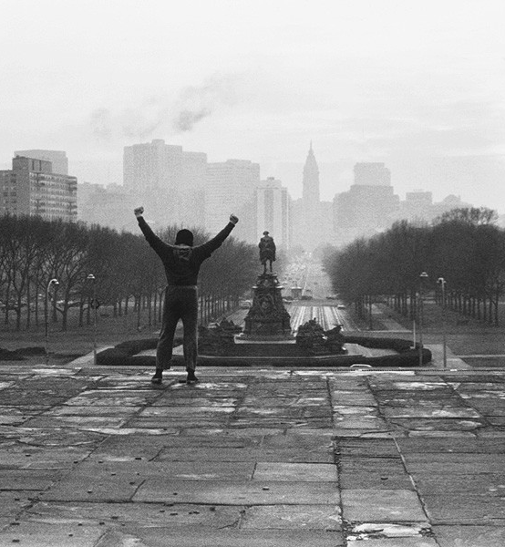
PHILADELPHIA’S EAST COAST CITY UNIVERSE (CIRCA 2017)
 | Philadelphia Rank
Median Earnings, Residents Age 25+ | 5 of 5
Median Monthly Owner Cost | 5 of 5
Median Home Value | 4 of 5
Per Capita Income | 5 of 5
Median Household Income | 5 of 5
Lowest Poverty Rate | 5 of 5
Lowest Unemployment Rate | 5 of 5
Educational Attainment: High School | 4 of 5
Educational Attainment: BA or Higher | 5 of 5
Credit Rating (Moody’s) | 5 of 5
Federal Locality Pay Adjustment | 5 of 5
Median Tenure Police Officer – Net Take Home Pay Per Hour Worked | 3 of 5
20-Year Career Average Police Officer – Net Take Home Pay Per Hour Worked | 3 of 5
25-Year Career Average Police Officer – Net Take Home Pay Per Hour Worked | 3 of 5
30-Year Career Average Police Officer – Net Take Home Pay Per Hour Worked | 3 of 5

Slide 36
VALLEJO BANKRUPTCY
When the City of Vallejo filed for bankruptcy in the midst of finalizing its CBAs, it became apparent that the City could not keep pace with the preestablished universe in the MOU

Slide 37
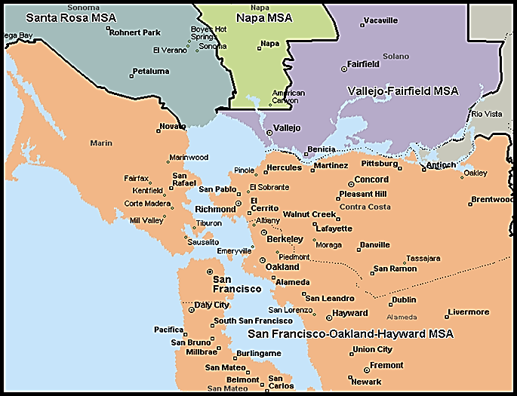
VALLEJO BANKRUPTCY
As shown on the following slides, the Vallejo–Fairfield MSA ranked lower in terms of key economic factors (e.g., income levels, housing costs) than the San Francisco-Oakland-Hayward MSA, to which many of its former comparator cities belonged
Vallejo-Fairfield MSA | San Francisco-Oakland-Hayward MSA
Vallejo | Alameda
 | Berkeley
 | Daly City
 | Hayward
 | Oakland
 | Richmond
 | San Leandro

Slide 38
VALLEJO BANKRUPTCY
The average annual wage in the Vallejo-Fairfield MSA general labor market was 22% lower than that in the San Francisco-Oakland-Hayward MSA
 | Vallejo-Fairfield MSA | San Francisco-Oakland-Hayward MSA
Per Capita Income (2012) | $27,589 | $40,522
Median Household Income (2012) | $62,066 | $74,922
Unemployment Rate (August 2013) | 8.2% | 6.5%
Median Owner Occupied Monthly Housing Cost (2012) | $1,949 | $2,653
Median Home Value (2012) | $234,900 | $557,700
Population Change (2002-2012) | 2.8% | 6.9%

Slide 39
VALLEJO BANKRUPTCY
Vallejo is in the distinct Vallejo-Fairfield Metropolitan Statistical Area (MSA), and did not have an economy like that of the Bay Area

Slide 40
VALLEJO BANKRUPTCY
Over the prior ten years (as measured from 1/1/2003 to 1/1/2013), Vallejo’s population had declined by 1.5%
Among the 13 comparison jurisdictions (reflecting the “unincorporated” parts of Solano County only), the average 10-year population change saw an increase of 4.8%
Source: California Department of Finance, E-1 and E-4 Cities, Counties, and the State Population Estimates

Slide 41
VALLEJO BANKRUPTCY
Vallejo’s per capita income of $23,334 ranked 12th out of the 13 comparison jurisdictions
Source: US Census Bureau, 2012 American Community Survey. As 2012 American Community Survey data is not available for geographies with populations below 65,000, the 2009-2011 ACS 3 Year Estimates were used for Benicia and 2007-2011 ACS 5 Year Estimates were used for Dixon.

Slide 42
VALLEJO BANKRUPTCY
Vallejo’s median household income was lower than 10 out of 13 comparison jurisdictions
Source: US Census Bureau, 2012 American Community Survey. As 2012 American Community Survey data is not available for geographies with populations below 65,000, the 2009-2011 ACS 3 Year Estimates were used for Benicia and 2007-2011 ACS 5 Year Estimates were used for Dixon.

Slide 43
VALLEJO BANKRUPTCY
Vallejo’s unemployment rate as of August 2013 (10.1%) ranked 11th out of the 13 comparison jurisdictions
Source: California Employment Development Department, Monthly Labor Force Data for Cities and Census Designated Places (CDP), August 2013 (Preliminary)

Slide 44
VALLEJO BANKRUPTCY
As of the then-most recent 2012 Census estimates, Vallejo’s median owner-occupied monthly housing costs were well below the comparison group average of $2,097
Source: US Census Bureau, 2012 American Community Survey. As 2012 American Community Survey data is not available for geographies with populations below 65,000, the 2009-2011 ACS 3 Year Estimates were used for Benicia and 2007-2011 ACS 5 Year Estimates were used for Dixon.

Slide 45
VALLEJO BANKRUPTCY
Similarly, Vallejo had the lowest median home value in 2012 according to the then-most recent data published by the Census Bureau
Source: US Census Bureau, 2012 American Community Survey. As 2012 American Community Survey data is not available for geographies with populations below 65,000, the 2009-2011 ACS 3 Year Estimates were used for Benicia and 2007-2011 ACS 5 Year Estimates were used for Dixon.

Slide 46
VALLEJO BANKRUPTCY
As of August 2013, Vallejo’s median home sale price of $230,000 was ranked last out of the 13 comparable jurisdictions and more than $130,000 below the average sale price of $355,173 across the 13 other jurisdictions
Source: DataQuick California Home Sale Activity

Slide 47
VALLEJO BANKRUPTCY
Vallejo’s foreclosure rate was among the highest across the comparable jurisdictions
The foreclosure rate can have a significant impact on property tax revenues
Source: RealtyTrac - Foreclosure Trend Summaries

Slide 48
VALLEJO BANKRUPTCY
With lower housing costs and a largely institutional business sector, Vallejo’s assessed value per capita was the lowest among the comparison jurisdictions, indicating a weaker revenue generating capacity
Sources: : California Department of Finance, E-1 Cities, Counties, and the State Population Estimates; State of California, Office of California Controller, Cities Annual Report Fiscal Year 2010-2011; State of California, Office of California Controller, Counties Annual Report Fiscal Year 2010-2011

Slide 49
VALLEJO BANKRUPTCY
Vallejo’s taxable sales per capita were also well below the average across this group, again indicating a weaker local economy and lower revenue generating capacity
Source: : California Department of Finance, E-1 Cities, Counties, and the State Population Estimates; State of California, State Board of Equalization, Taxable Sales for Calendar Year 2011

Slide 50
VALLEJO BANKRUPTCY
Thus, in In re City of Vallejo, the court ruled in favor of the City.

Slide 51
SUMMARY
Comparability is equal parts art and science
However, thoughtful and credible comparability work can help dispel misconceptions of bargaining groups
On the other hand, aligning yourself with the wrong universe sets misguided expectations and may lead to unsustainable compensation levels
And, remember, whatever universe you are living in, being less than average isn’t necessarily bad;
someone has to be…

