Slide 1

Financial Outlook for Negotiators and Human Resource Professionals
CALPELRA Annual Conference
November 19, 2020

Slide 2




Introductions
Michael Coleman is a leading expert on California local government revenues, spending and financing. He is the creator of CaliforniaCityFinance.com, the California Local Government Finance Almanac, an online resource of data, analyses and articles on California municipal finance and budgeting. He is the principal fiscal policy advisor both to the California Society of Municipal Finance Officers (CSMFO) and, for over twenty-five years, to the League of California Cities.
Russ Branson is the founder of Russ Branson Consulting. Mr. Branson works with local governments and special districts addressing difficult financial issues facing municipal governments today. Prior to starting his own firm, he was a Director for Public Financial Management (PFM) and was responsible for overseeing a range of services including the development of long-range financial plans, ensuring sustainable financial health, and optimizing municipal performance.
Jonathan Holtzman is a founding partner of Renne Public Law Group. His practice focuses on assisting government agencies maintain, innovate and expand public services through strategic consulting, negotiations, fact finding, arbitration, and litigation.
2

Slide 3
What Will Bargaining in 2021/22 Look Like?
Most public agencies are facing operating losses due to loss of revenue.
There continues to be a great deal of uncertainty about public finances due to COVID-19.
The extent of economic problems varies greatly from jurisdiction to jurisdiction based on revenue sources and regional differences.
Maintaining adequate reserves will be challenging
3

Slide 4
What is Your Plan for 2021 Bargaining?
Duration of agreement: the most prudent course is a one-year agreement due to the level of uncertainty
  Can your jurisdiction sustain a “roll-over” with no changes in compensation?
  If not, are your elected decision-makers prepared to seek concessions?
  Are your elected decision-makers prepared to layoff employees?
  Are unions prepared to accept concessions to avert layoffs?
4

Slide 5
Fact-Based Bargaining
In a concessionary environment, communication of facts is critical
  The presentations you are about to hear are intended to help you think about communications that go beyond just the bottom-line.
  In a roll-over or concessionary environment, human resources professionals need to become their own experts on all of the moving parts involved in your jurisdiction’s finances.
  Both elected officials and unions continue to be in denial about the seriousness of the current downturn in revenues.
  While facts are not always welcomed, they’re the only tool to reaching voluntary agreements in the current environment
5

Slide 6
Change in the Air
A California Local Government Finance Update
6

Slide 7
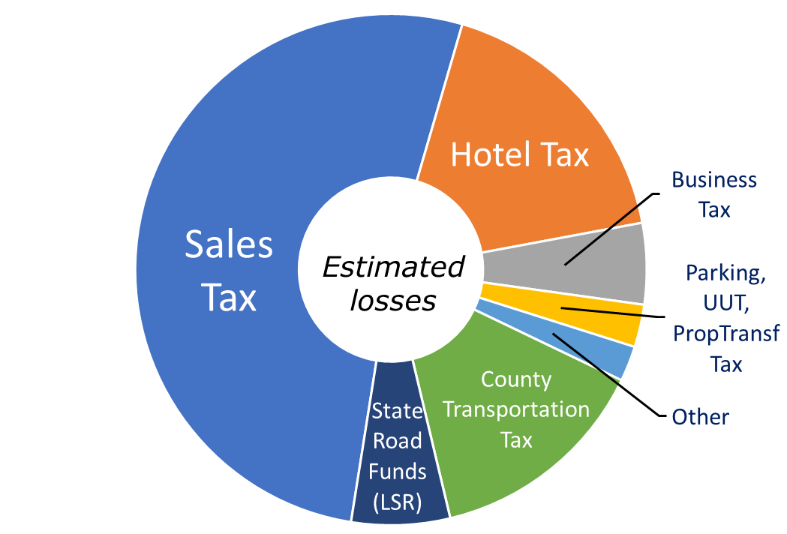
City Revenue Impacts – COVID-19
7

Slide 8
City Revenue Impacts – COVID-19
Financial impact estimating is a squirrel:
Moving target … clearer as we go.
Expect more frequent financial updates than in the past.
8

Slide 9
City Revenue Impacts – COVID-19
Financial impact estimating is a squirrel:
Moving target … clearer as we go.
Expect more frequent financial updates than in the past.
Each of these things is not like the others:
Your situation is unique. Most impacts depend on the unique character of your local economic base.
9

Slide 10
Taxable Sales in California: 2020-Q2 v 2019-Q2
Apparel
Service Stations
-55%
-47%
Eating & Drinking
-48%
10
Source: California Department of Tax and Fee Administration.

Slide 11
Taxable Sales in California: 2020-Q2 v 2019-Q2
Apparel
Service Stations
Electronics
Furniture
Appliances…
-55%
-47%
-17%
Eating & Drinking
Motor Vehicles
-48%
-15%
Merchandise
-10%
11
Source: California Department of Tax and Fee Administration.

Slide 12
Taxable Sales in California: 2020-Q2 v 2019-Q2
Apparel
Service Stations
Electronics
Furniture
Appliances…
-55%
-47%
-17%
Eating & Drinking
Motor Vehicles
+2%
-15%
Food Markets
-48%
+12%
+181%
Merchandise
Building
Materials
Non-Store Retail
-10%
12
Source: California Department of Tax and Fee Administration.

Slide 13
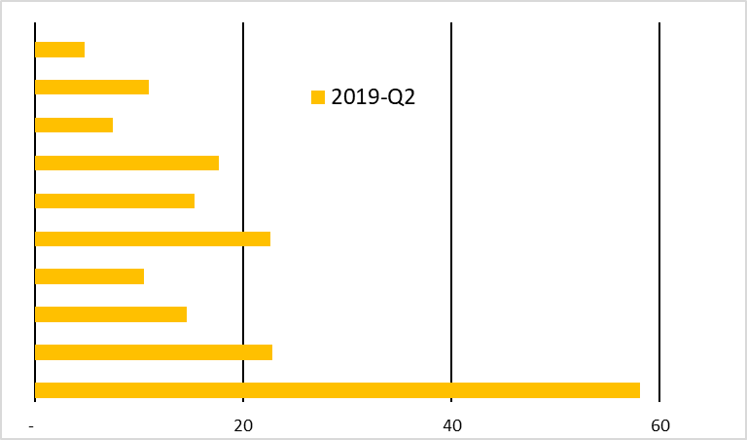
Taxable Sales in California: 2020-Q2 v 2019-Q2
NonStore Retail
Building Materials
Food Markets
Merchandise
Electronics/Appliances
Furniture/SportingGoods, etc.
Motor Vehicles
Apparel
Service Stations
Eating & Drinking
Other
13
Source: California Department of Tax and Fee Administration.

Slide 14
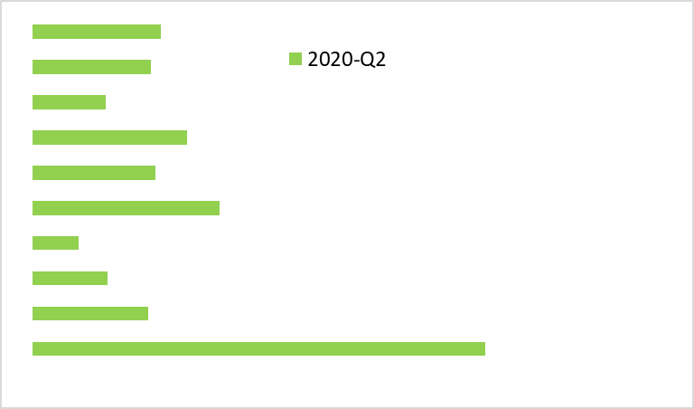
Taxable Sales in California: 2020-Q2 v 2019-Q2
NonStore Retail
Building Materials
Food Markets
Merchandise
Electronics/Appliances
Furniture/SportingGoods, etc.
Motor Vehicles
Apparel
Service Stations
Eating & Drinking
Other
+181%
+12%
+2%
-10%
- 17%
-15%
-54%
-47%
-47%
-19%
14
Source: California Department of Tax and Fee Administration.

Slide 15
Taxable Sales
15

Slide 16
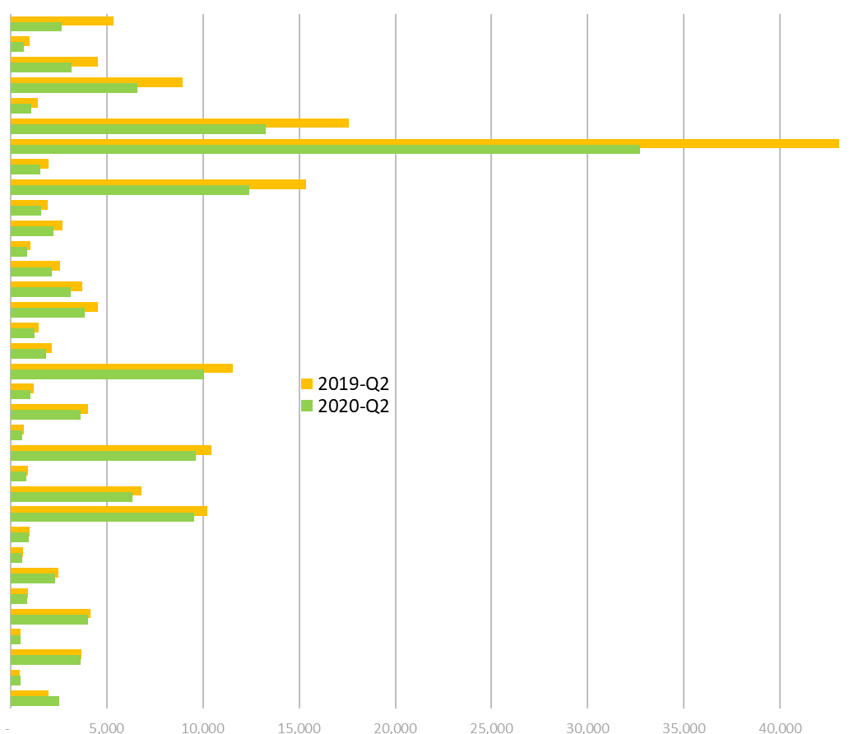
Taxable Sales
16

Slide 17
Taxable Sales in California: 2020-Q2 v 2019-Q2
17
Source: California Department of Tax and Fee Administration.

Slide 18
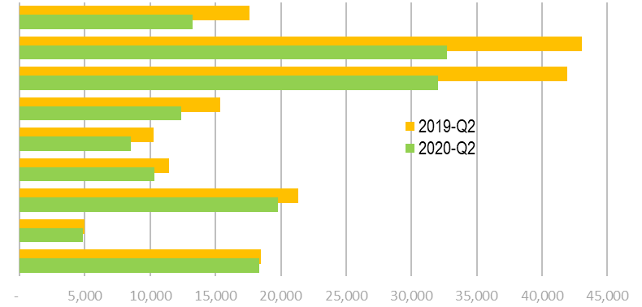
Taxable Sales in California: 2020-Q2 v 2019-Q2
18
Source: California Department of Tax and Fee Administration.

Slide 19

Effects of Better Sales Tax Collection
AB147 (Burke) and South Dakota v. Wayfair
19

Slide 20
Effects of Better Sales Tax Collection
AB147 (Burke) and South Dakota v. Wayfair
Baked in with other collections – cannot be clearly distinguished
20

Slide 21
Effects of Better Sales Tax Collection
AB147 (Burke) and South Dakota v. Wayfair
Baked in with other collections – cannot be clearly distinguished
Improved out of state collections – allocated through “pool” system
21

Slide 22
Effects of Better Sales Tax Collection
AB147 (Burke) and South Dakota v. Wayfair
Baked in with other collections – cannot be clearly distinguished
Improved out of state collections – allocated through “pool” system
Some shift to “in-state” on-line … so sales tax goes to retailer location
22

Slide 23
Effects of Better Sales Tax Collection
AB147 (Burke) and South Dakota v. Wayfair
Baked in with other collections – cannot be clearly distinguished
Improved out of state collections – allocated through “pool” system
Some shift to “in-state” on-line … so sales tax goes to retailer location
Improved collections of Transactions and Use Tax (add-on rates)
Allocated direct to product user/recipient location
Also improved collection of in-state online TUT
23

Slide 24

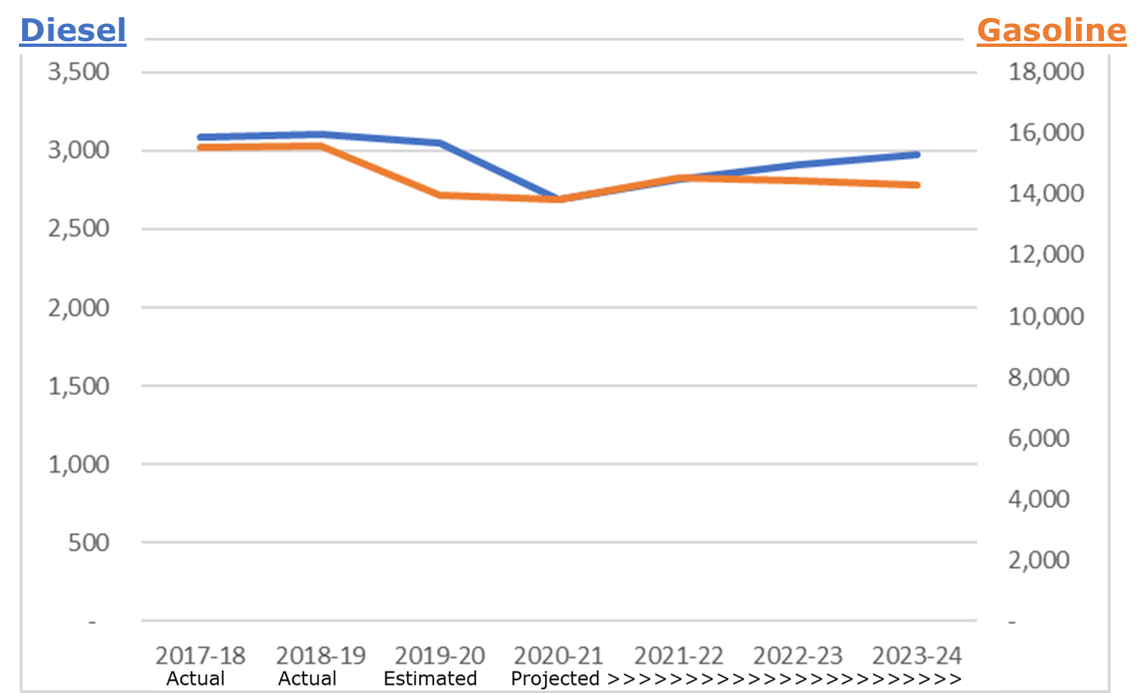
Fuel Consumption
24
Source: California Transportation Commission.

Slide 25
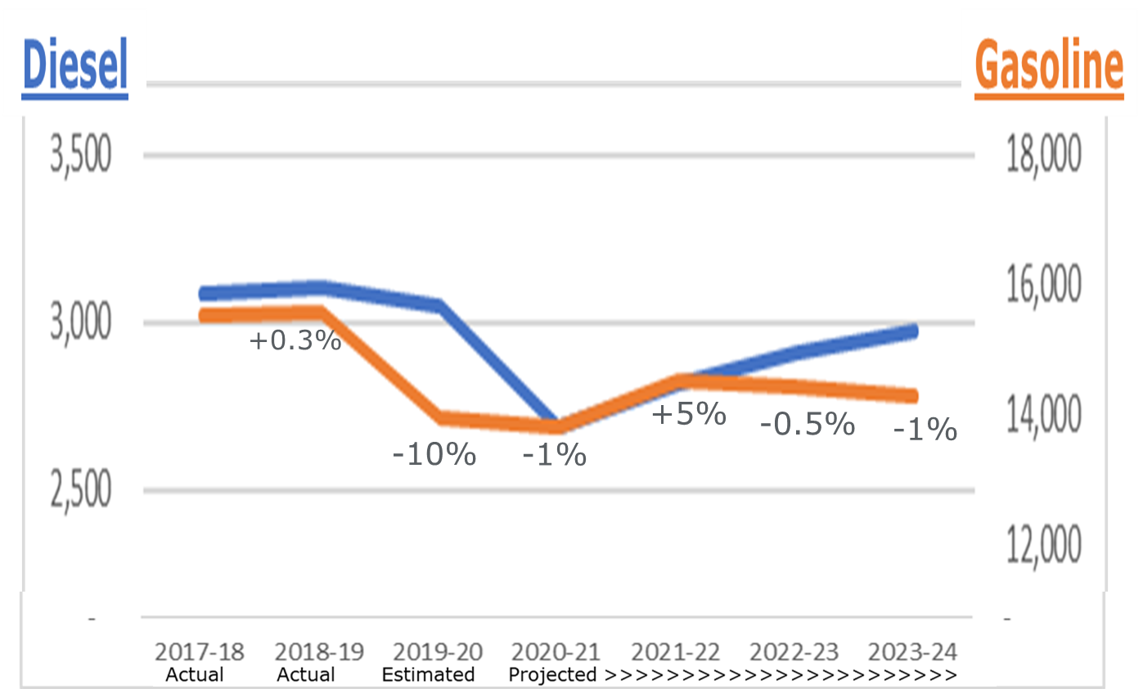
Fuel Consumption
25
Source: California Transportation Commission.

Slide 26
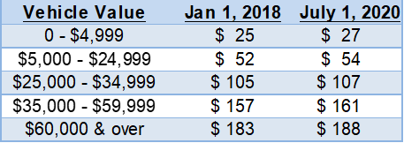
Fuel and Registration Tax Increases
Transportation
Improvement Fee
Diesel
Excise Tax
36.0¢ ➔ 38.5¢
Gasoline Excise Tax
47.3¢ ➔ 50.5¢
Plus new ZEV
Registration Fee
$100/yr on 2020 models / later
26

Slide 27
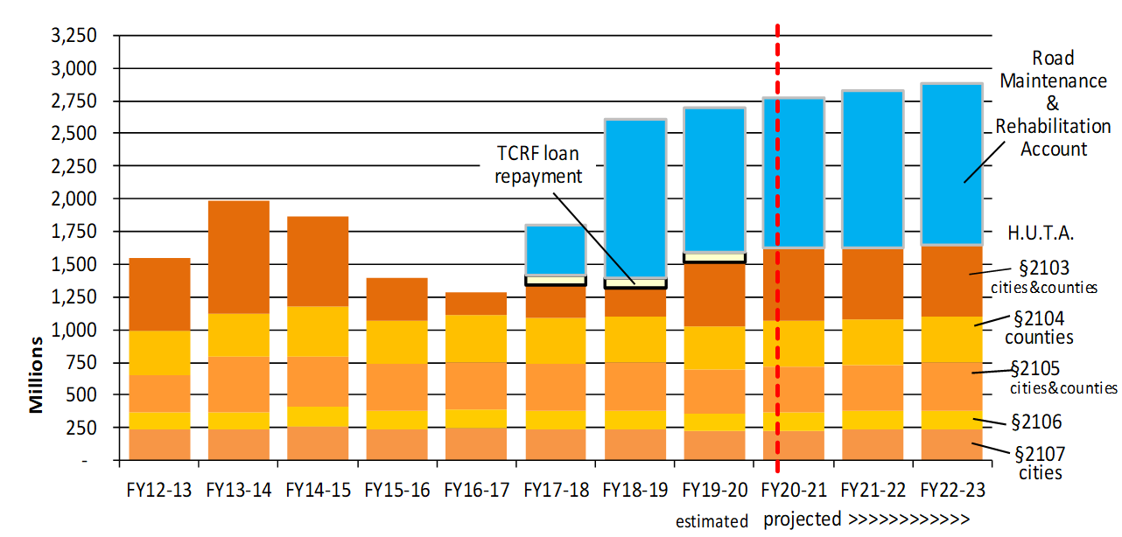
Local Streets and Roads $ to Cities and Counties
27

Slide 28
Local Streets and Roads Revenues Key Points
FY2019-20 revenues down from prior estimates due to COVID-19 drop in fuel consumption …
… but due to tax rate increases …
FY2019-20 revenues are still up 3.3% over FY2018-19.
FY2020-21 projected to increase 2.7% over FY2019-20.
28

Slide 29

Local Tax and Bond
Measure Results
29

Slide 30
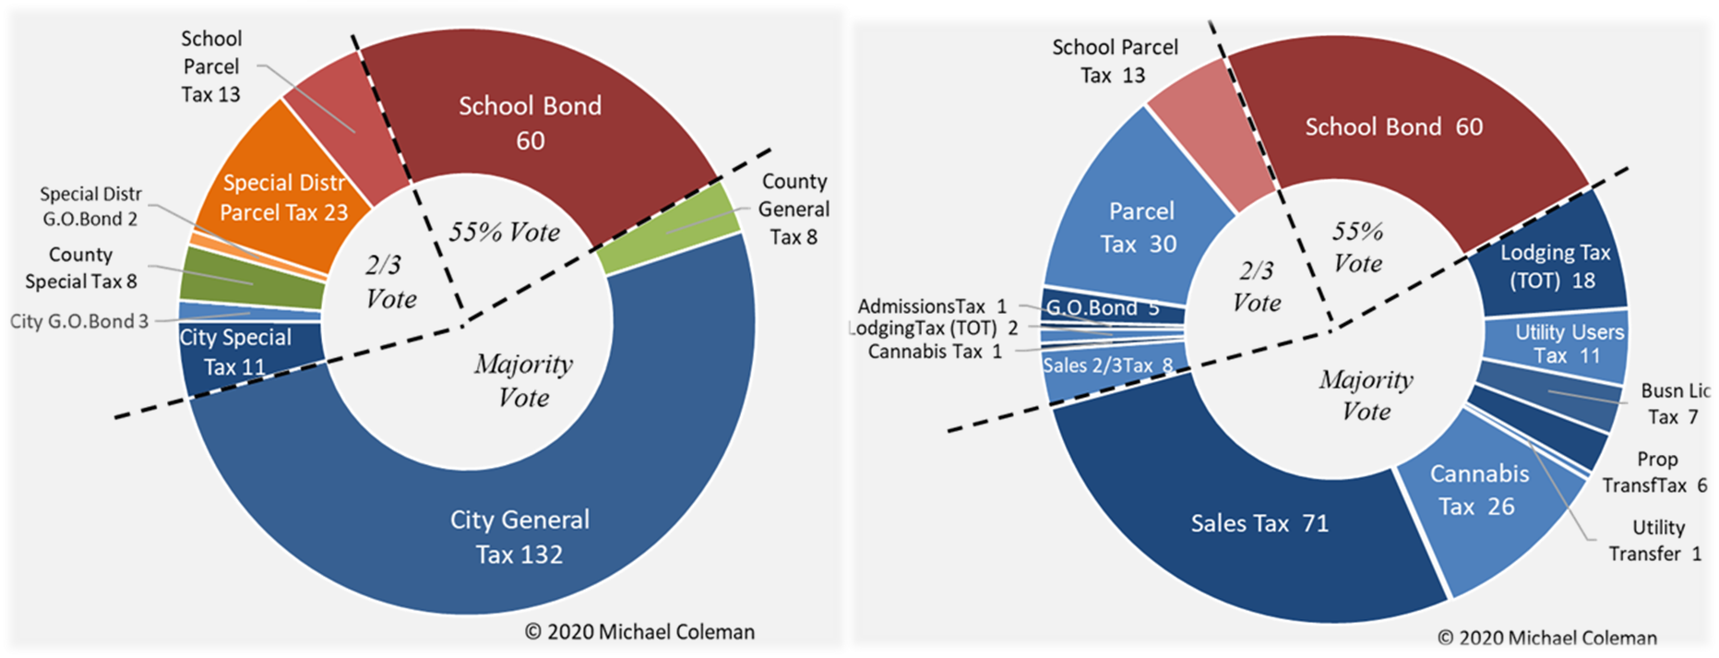
Local Tax & Bond Measures November 2020
30
Source: County Elections Offices.

Slide 31

Local Tax & Bond Measures November 2020
31
Source: County Elections Offices.

Slide 32
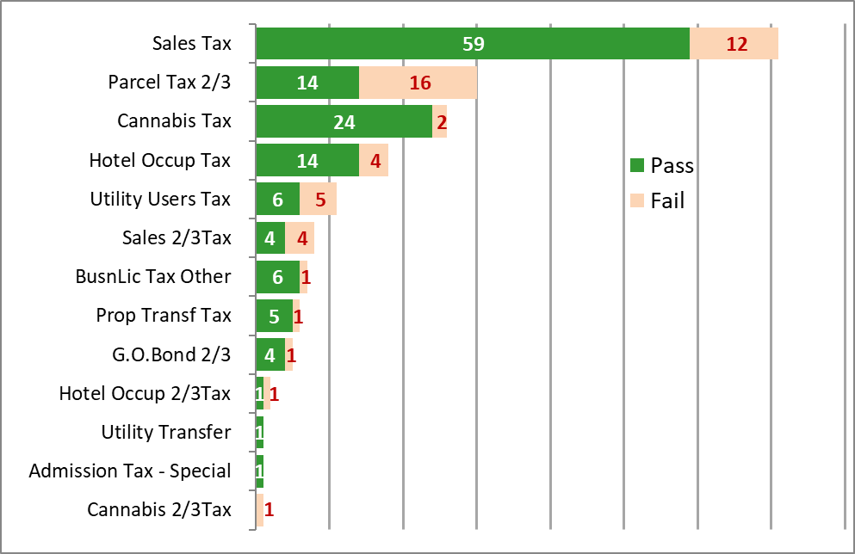
Local Tax & Bond Measures November 2020
32
Source: County Elections Offices.

Slide 33
Preparing for Labor Negotiations
Key Points in Evaluating Financial Condition
33

Slide 34


What We Are Facing….
Running out of cash?
Unbalanced budgets?
Uncertainty!!!!!!!!!!!!!!!!!!!!!
Concession Bargaining?
Bankruptcy?
34
Notes:
Santa Cruz County – MSA OMB
MSA figures include Watsonville, county excluding Watsonville
This is demonstrated by the fact that the City has more problematic demographics than Santa Cruz County in terms of unemployment, income levels, poverty and home values. These economic weaknesses show up as a combination of lower revenues to provide services to the community

Slide 35
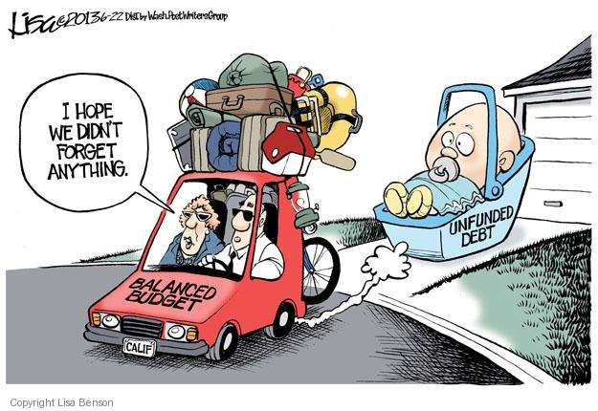
A Balanced Budget…Is Not
Being able to pay your bills this year
Borrowing to make ends meet
Ignoring pressing maintenance needs because you can’t afford to fix them
Drawing down reserves—using one- time money for ongoing expenses—with no plan to rebuild them to policy levels
Pushing off other current (or past) expenses to the future in order to increase compensation… leading to an inability to pay for current or past obligations
35

Slide 36
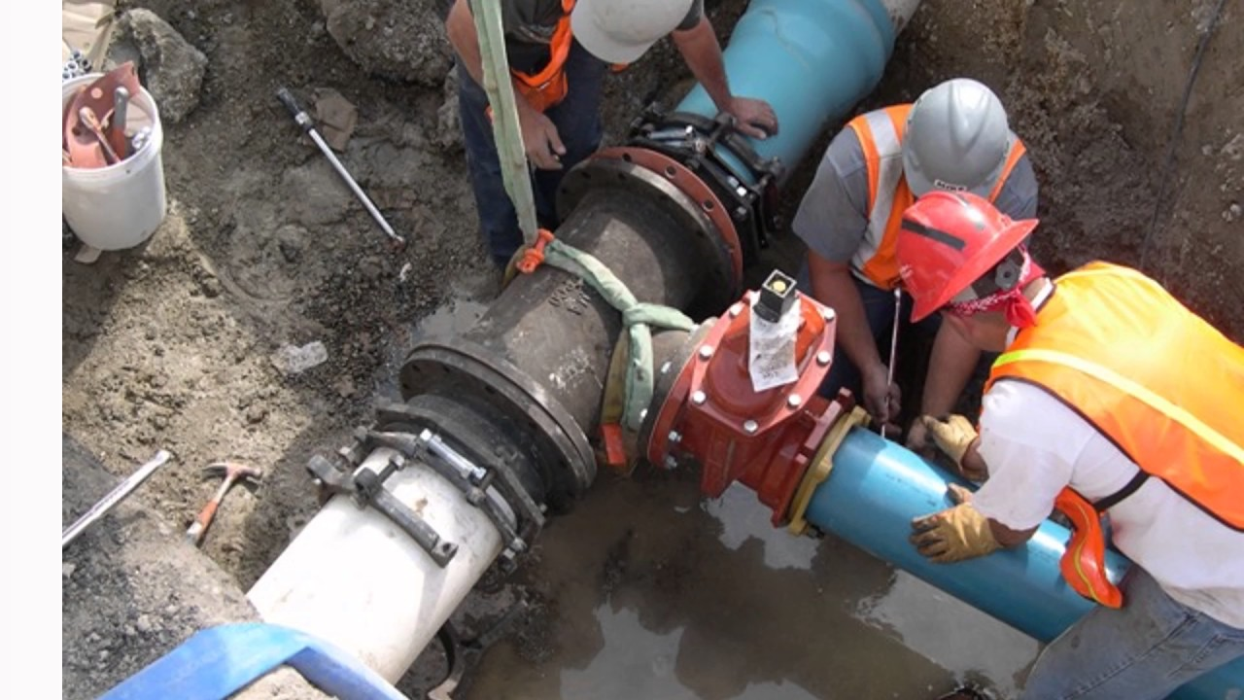

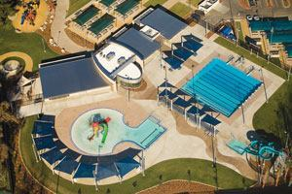
What a Balanced Budget Includes
Deferred Maintenance
  Streets & Buildings
  Parks & Playgrounds
  Technology
If you can’t afford what it takes to run your agency…you need to adjust all expenses
Use of the adopted budget alone can create downstream issues
Retiree Benefits
  Buffer pension increases
  OPEB & Retiree Payoffs
Investment
Community Investments
  Pools/Recreation/Youth Programs
  Community Centers/Libraries
Balanced Budget
Liabilities
Services & Supplies
Personnel Expenses
36
Notes:
Know what your sustainable budget really is:
Deferred maintenance
Community investment needs
Unfunded liabilities
Impact of Coming pension cost increases
Major changes in revenue or expense not in your current budget
Maintaining proper budget reserves
The COVID-19 context is also important
Use of reserves that need to be replaced
Use of layoffs or furloughs need to be considered
Often excludes deferred maintenance and
community investment
Lack of addressing unfunded OPEB liabilities
Pension costs are trailing the growth curve

Slide 37



Components for Budget Sustainability
A sustainable budget identifies and addresses ongoing past issues, your present circumstances, and what you know is coming….
Ongoing Impacts
  Recovery from last recession
  Unfunded liabilities
Current Position
  Reserves
  What is not in your budget
Coming Impacts
  Pension costs
  Reserve replenishment
37
Notes:
Past = Trajectory
Current =
Maintenance – leading to growing deferred maintenance
Parks – playgrounds and athletic facilities
Buildings – government and community centers
Roads – Logarithmic increase in costs with lack of regular maintenance regime
Long-term Pension and OPEB costs
Discount rate overshoot
CalPERS return of 4.3% in FY20 will lead to UAL increases starting in FY23 and peaking in FY27
Poor actuarial decisions
CalPERS open-ended 30-year amortization has led to growing UAL now in fixing that issue
Current CalPERS 20-year amortization still has 5-year ramp up resulting in negative amortization over first five years
Assumed salary growth of 2.75% per year is out-of-step with current fiscal situation and will lead to increased UAL in future years
Full funding of OPEB liabilities is rare for agencies

Slide 38
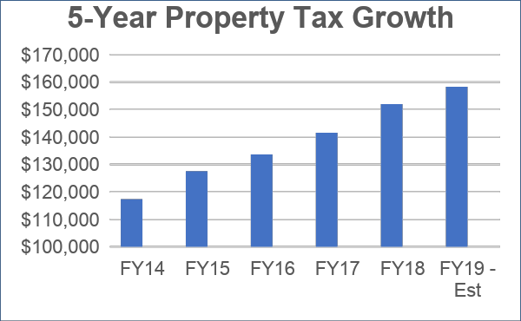

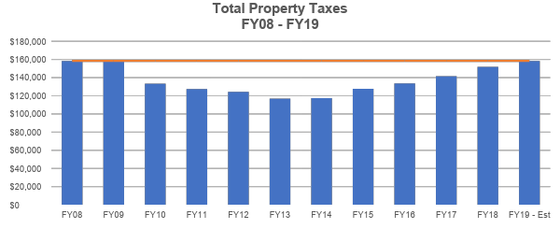
PAST: Recovery Was Slow
Many agencies took more than a decade to recover key revenue sources
In showing these impacts, a recent-term view can tell a misleading story
38
Notes:
Many jurisdictions were just recovering from the Great Recession when the pandemic hit. But to see this, you have to take a longer view back. If just looking at the last five years, this City looks like property taxes were taking off, but a longer view shows that it was just recovering from the Great Recssion, and to keep up with inflation, should have been 15.5% higher that they got to FY19

Slide 39
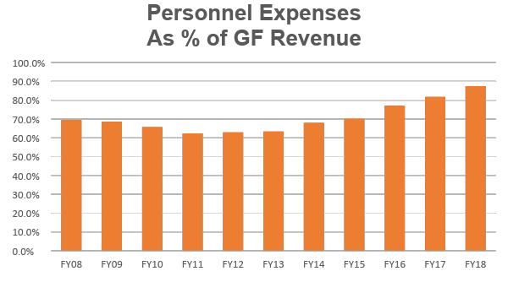
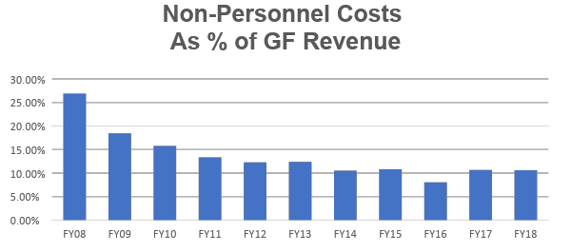
PAST: Expense Trends
Dangerously high ratio of cost/revenue
For most agencies, personnel costs have recovered from the recession and are a growing share of GF revenues
Non-personnel costs suffered, and often remain at historical low funding levels
Let your data to the heavy lifting in telling your Great-Recession-recovery story
39

Slide 40
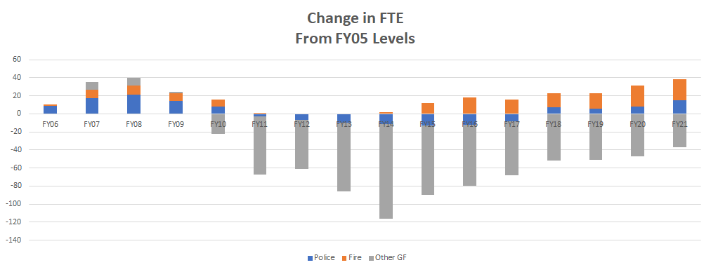
PAST AND PRESENT: Employees
This chart shows one City’s FTE journey​
While public safety positions have surpassed levels from FY05, miscellaneous employees are still significantly under FY05 levels​
40

Slide 41
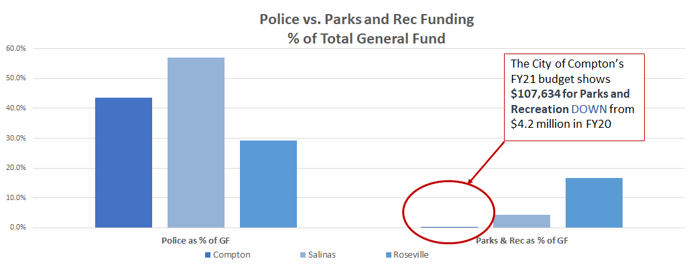
PRESENT: Service Solvency​
Funding for police vs. parks and recreation looks very different depending on your community
Understand your current service solvency and where you can afford to cut back​
41
Sources: Online budgets for Compton, Salinas, and Roseville
Sources: Online budgets for Compton, Salinas, and Roseville​
Notes:
Compton 98K pop, 75% people of color
Salinas 166K pop. 86% people of color
Roseville 145K pop 21% people of color

Slide 42
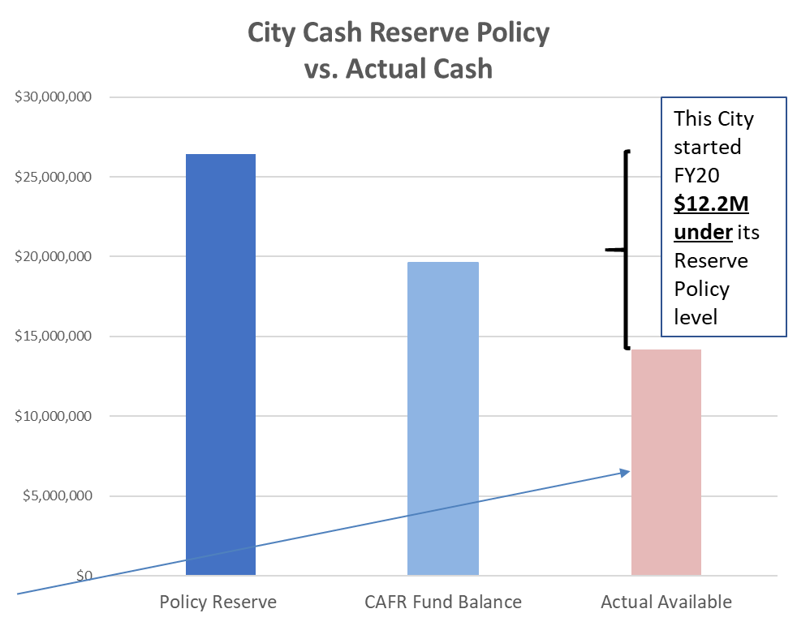
PRESENT: Reserve Levels
GFOA recommends a minimum of two-months operating expense reserve…PLUS
Additional reserves should be added for special risk (fire, flood, earthquake, economic disruption, etc.)
…Are your reserves enough?
…Do you even have the reserves you think you do?
Other General Government Funds had a negative unassigned fund balance of $5.4M, reducing cash availability
42

Slide 43

FUTURE: Economic Vulnerability
A budget forecast can help communicate real budget vulnerabilities
Revenue volatility
Pensions and Health Care
Labor Costs
Reliance on new development
The cost of “business as usual” may increase your risk of major economic dislocation
43

Slide 44
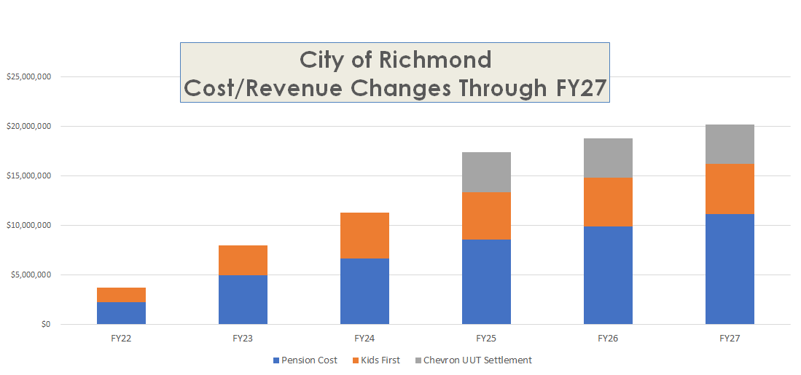
FUTURE: Known Impacts
44

Slide 45
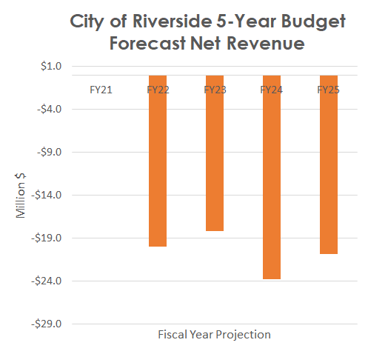
FUTURE: Budget Forecast
Does your forecast include:
Full cost of unfunded and needed maintenance?
Payment of your OPEB’s actuarially determined contribution (ADC)?
Continue upgrade of major technology systems (CAD/RMS, radios, computers, major software systems)
What trends does it show?
What does the forecast tell you about what decisions you should make now?
“The future depends on what we do in the present.”
- Mahatma Gandhi
Source: City of Riverside FY21 Budget Document
45

Slide 46
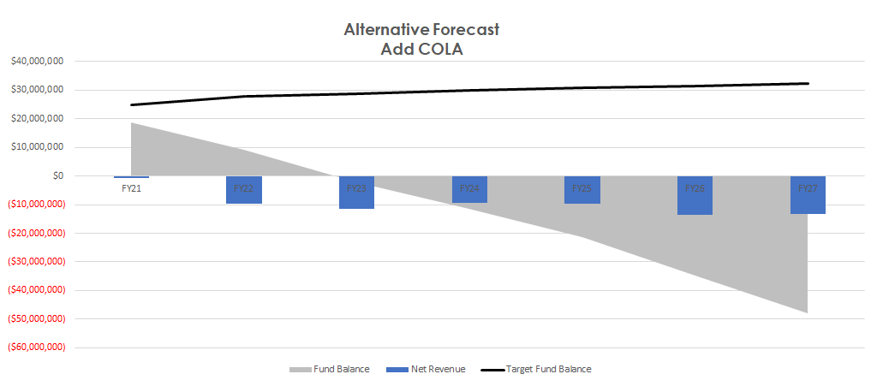
FUTURE: Impact of Labor Agreements
Show cost increases in context of the entire City budget
46
Notes:
As much as labor may not want to acknowledge budget forecast issues, they will want to over-estimate and accelerate potential future revenues (growth/prop. 15)

Slide 47
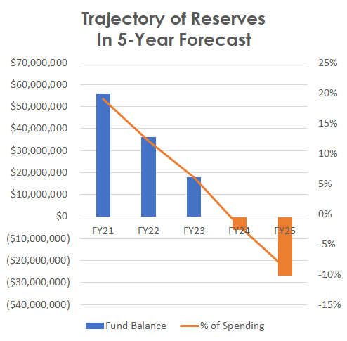
FUTURE: Reserve Trajectory
If your reserves are on a downward trend, be able to answer these questions:
What is the plan to get to a “balanced” budget?
How do personnel costs contribute to a downward trend?
If it takes you time to institute change, how will you rebuild reserves?
47

Slide 48
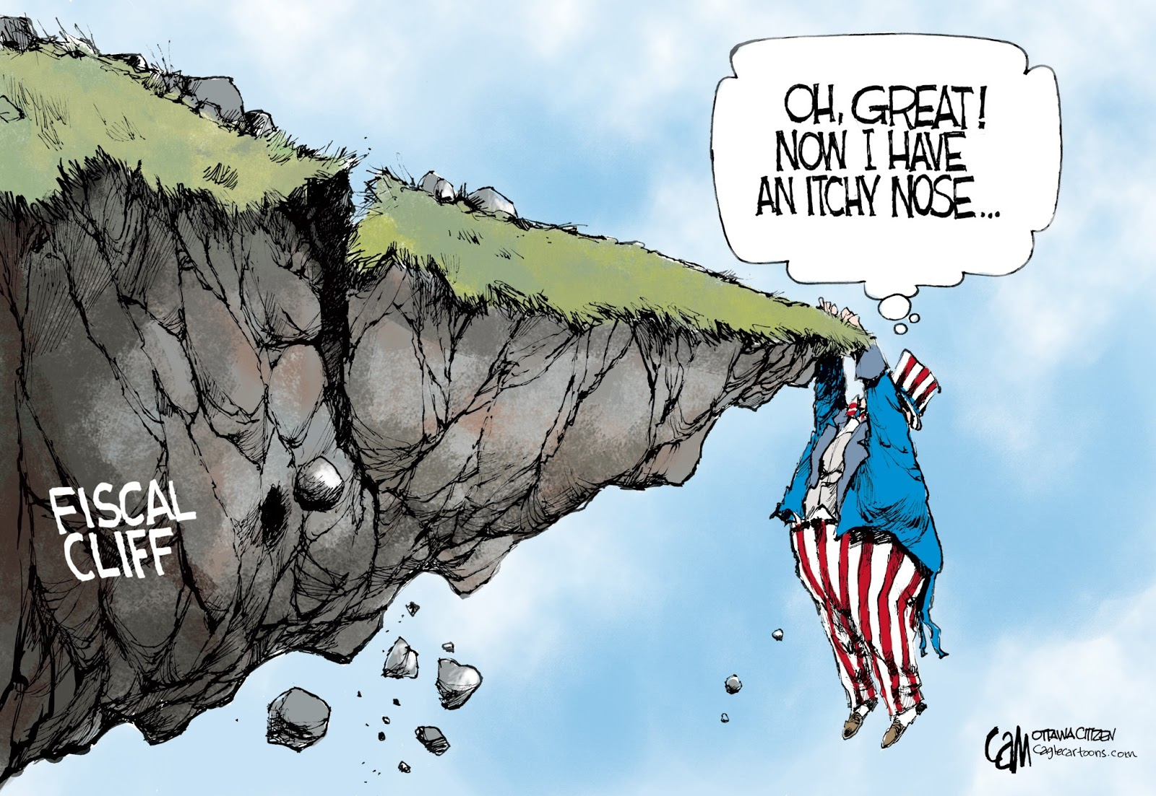
Let the facts do the work| Telling your story
Mine your data for your stories
How fast are you going through your reserves?
Uncertainty of future revenue levels – quick rebound vs. longer-term impacts
Longer-term impacts from pension increases, reserve replenishment, critical infrastructure needs
Show that uncertainty requires both caution and action—just hoping to hang on may not be the right strategy
48
Notes:
to the community

Slide 49
Overall Financial Approach
#1 - Know your data and present it in an accessible fashion
#2 - Put your labor negotiation in context of total agency needs
#3 - Talk about how labor cost fit into your agency’s current and long-term service strategy
#4 - Focus on what you need to do now to limit long-term financial sustainability issues​
49

Slide 50
Thank you!
Michael Coleman
coleman@muniwest.com
Russ Branson
russ@russbransonconsulting.com
Jonathan Holtzman
jholtzman@publiclawgroup.com

